Slide 1
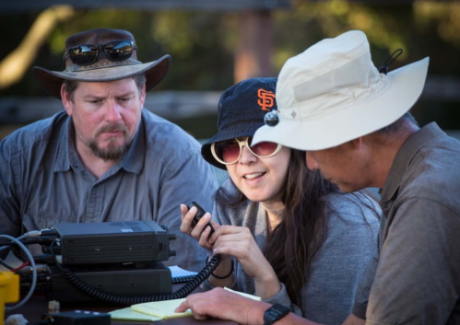
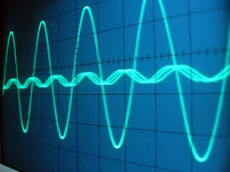
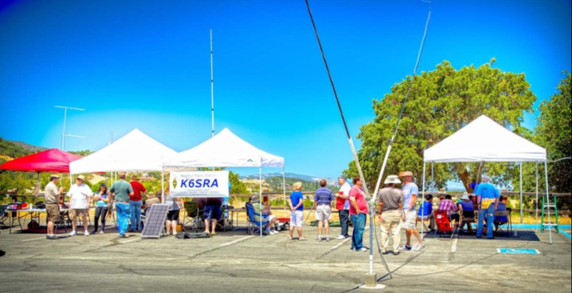
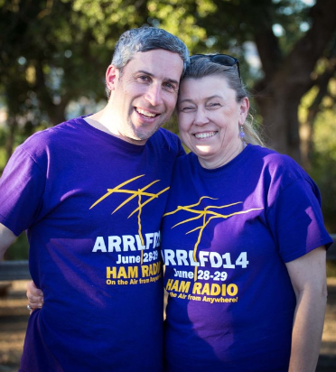
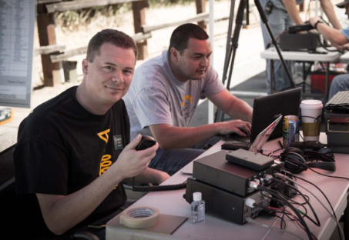
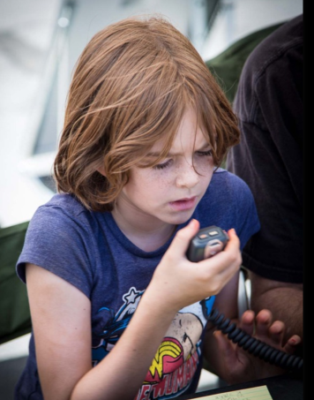
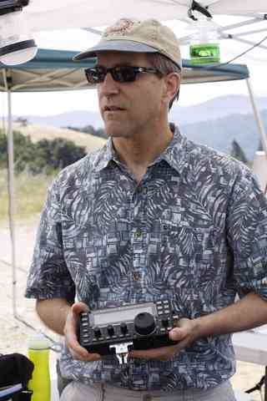
Welcome to Ham Radio 201 New General / Extra Session Sponsored by Bay-Net www.bay-net.org

Slide 2
Agenda
New Technician / New Licensee
8:00 Kickoff
8:15 VHF/UHF Gear - George
9:00 VHF/UHF Operating - Beric
9:45 VHF Digital Voice – George
New General / Extra
10:15 HF Gear - George
11:00 HF Operating - David
11:45 Q&A
12:00 Wrap up

Slide 3
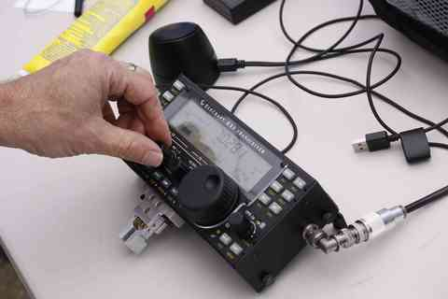
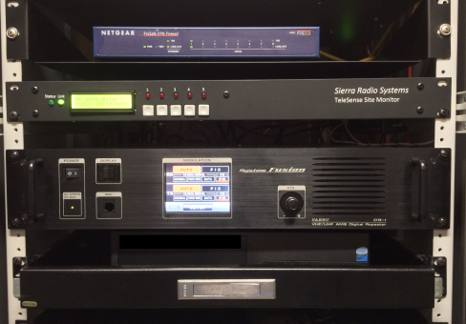
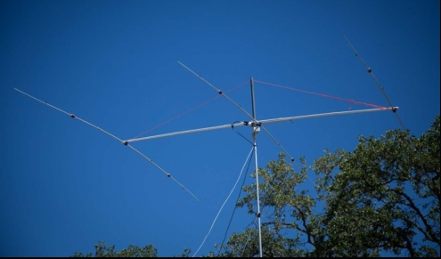
Bay-Net www.bay-net.org
Bay-Net
Virtual Amateur Radio Club
> 400 “members” – groups.io
7 repeaters @ 2 sites
Linked Analog FM with IRLP
D-Star, Fusion, DMR
Events
Field Day
Antenna Shootout
BayCon
Urban Shield
Supports
American Red Cross
FEMA USAR TF 3
Radio Mala - Nepal
501(C)3 Non-profit
Field Day !!!

Slide 4
Great Resources
Ham Radio Workbench Podcast www.hamradioworkbench.com
TX Factor www.tx factor.co.uk
The Doctor Is In www.arrl.org
QSO Today podcast www.qsotoday.com
Bay-Net website www.bay-net.org
BayCon 2020
Annual Bay-Net Radio Conference
February 8th - 9 AM – 5 PM
Plug-n-Play Tech Center – Sunnyvale

Slide 5
New General / Extra … Gear George KJ6VU Sponsored by Bay-Net www.bay-net.org

Slide 6
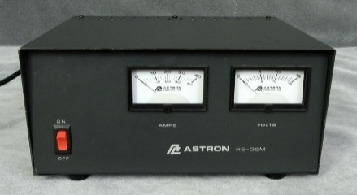
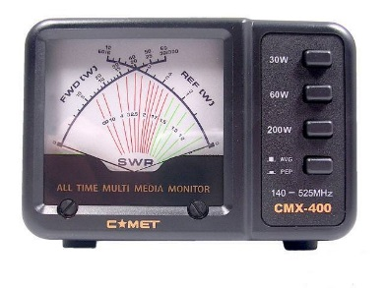
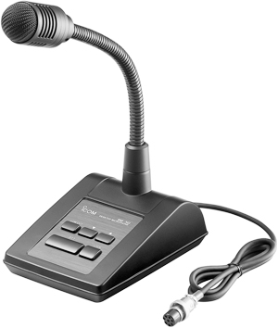
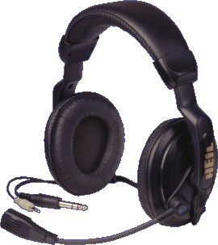
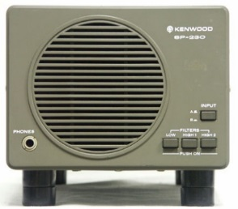
What’s in a Station?
Antenna
Feed Line
Power Supply
Radio
Watt
Meter
Headphones
Microphone
Speaker

Slide 7
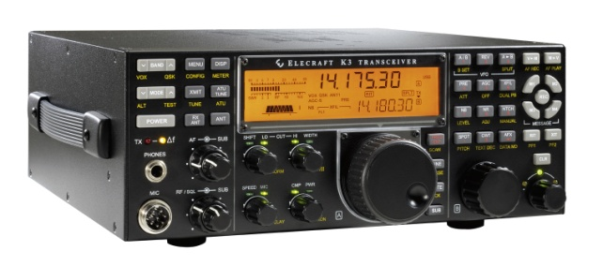
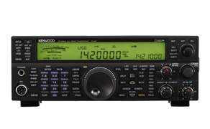
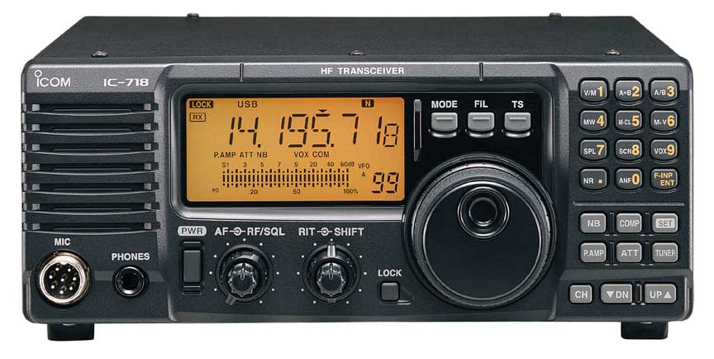
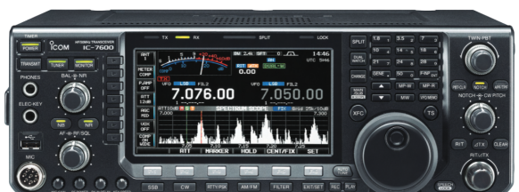
HF Radios
Good
Better
Best
$650-$1,000
$1,000-$2,000
$2,000-$4,000++
Standard features common to all radios
Frequency bands, Modes, Power output
So, what is the difference ???
Performance - Quality - User features

Slide 8
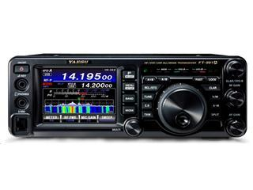
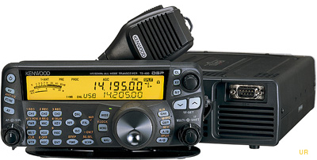
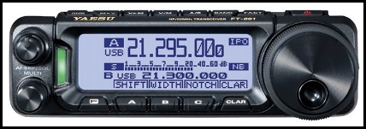
HF Portable / Mobile Radios Good Universal Rig
Same standard features as “base” radios
Some w/ VHF & UHF
Typically good / not great performance
Much smaller
Designed for mobile… good for portable
Easy to haul around
Can have a cramped user interface

Slide 9
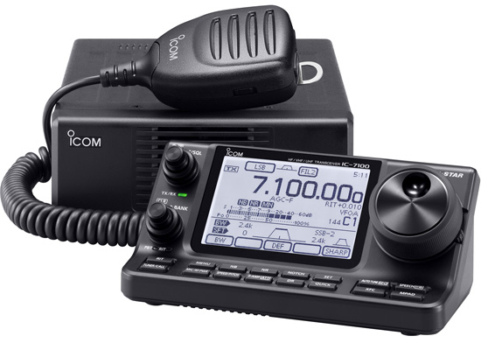
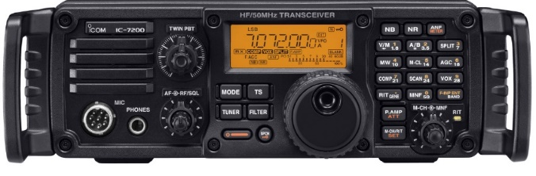
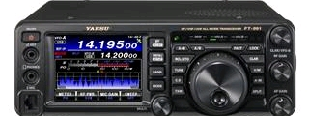
Multi Purpose / Special Purpose Radios
Icom IC-7100
HF, 6m, 2m, UHF
D-STAR
Mobile/Base config
Icom IC-7200
HF, 6m
Rugged
Easy to use
Yaesu FT-991A
HF, 6m, 2m, UHF
System Fusion
Part time spectrum display

Slide 10
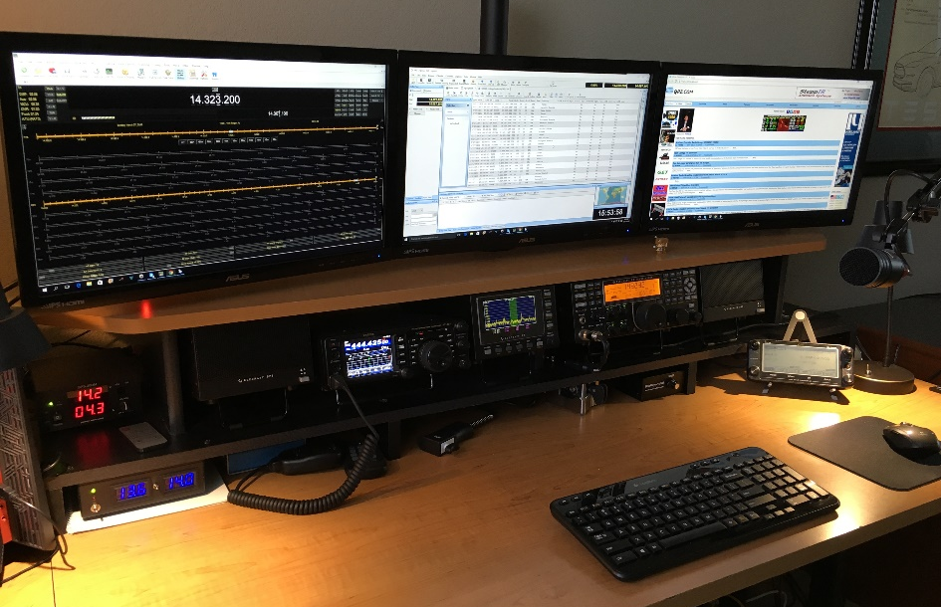
Mic
Speaker
ID-5100
K3
P3
FT-991A
Speaker
Keyer
Power
Paddle
Computer

Slide 11
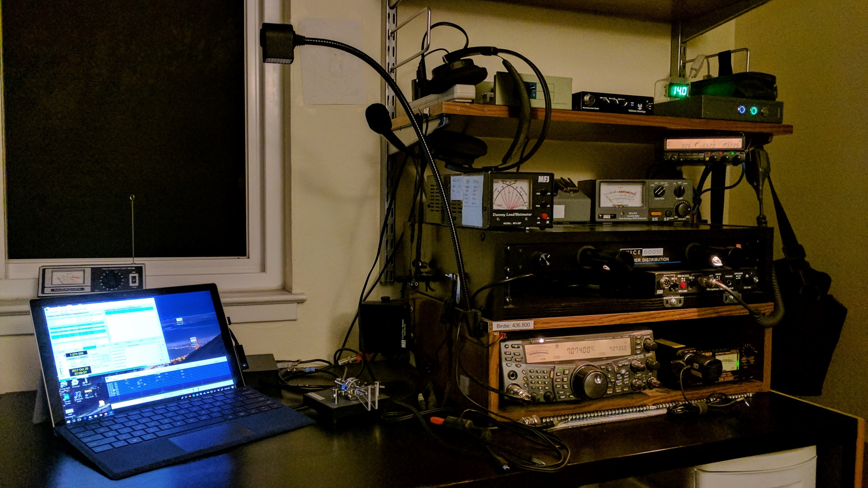
Digimode
Tuner
Headset
Ant Sw & Meters
TM-742A
EMF Meter
Speaker
Power Filter
Mic SW
TS-2000
Power
Paddle
120 Amp-hr AGM
Computer

Slide 12
Buy a Used Radio
A 20 year old radio is still a good radio
Price range: 50% to 75% of new pricing
Ebay – Craigslist – Local operators
Try before you buy if you can – and test it

Slide 13
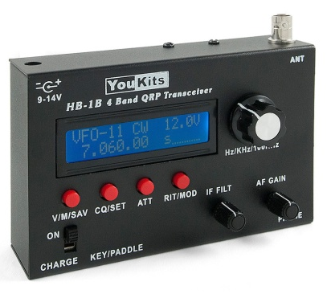
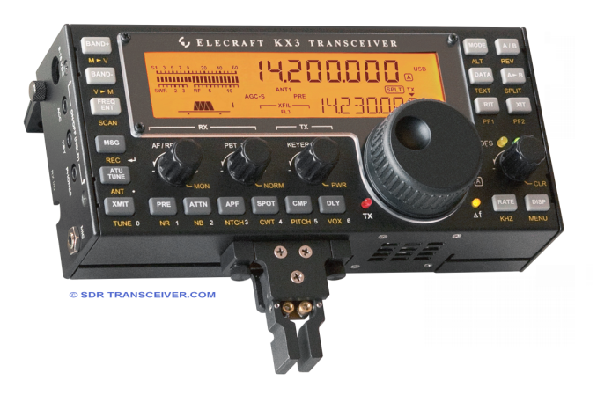
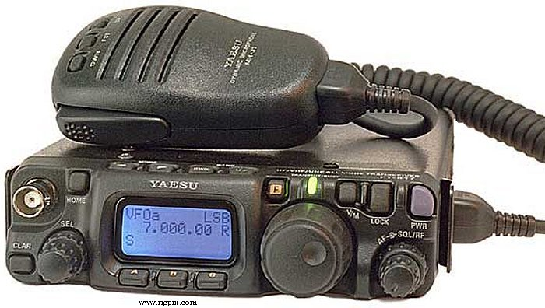
Portable Low Power Radios
$900+
$750
$300
Optimized for portable use
Backpacking / hiking / travel
Battery operated
Wide range of performance and features
Wide price range

Slide 14
Advanced Radio Features Typical On Modern Mid-Range Radios
Performance
Digital signal processing
Automatic notching
IF shift
More sensitive / selective
Lower noise Rx
Better Tx audio processing
Spectrum display / waterfall display
Antenna Tuner
Better Rx filters
Keyer
CW / RTTY / PSK decode

Slide 15
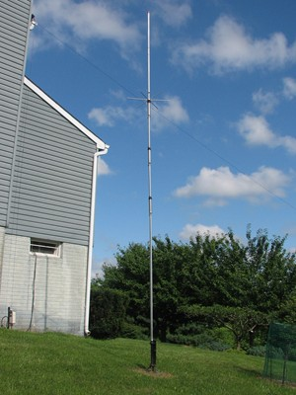
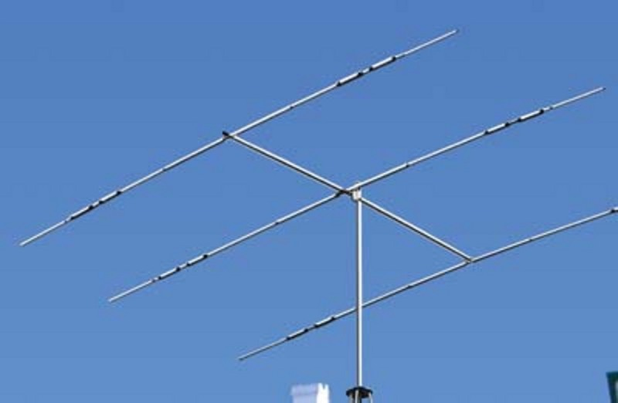
Typical Antennas
Wire Dipole
Vertical
Yagi

Slide 16
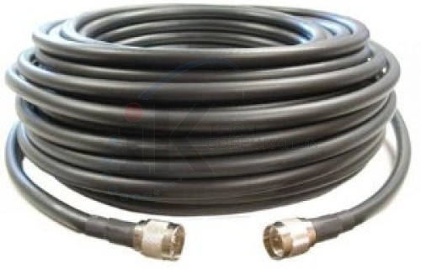
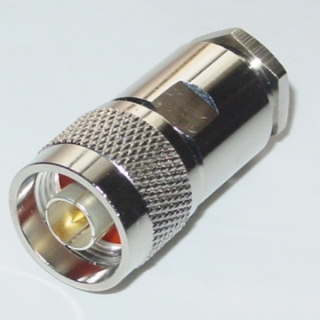
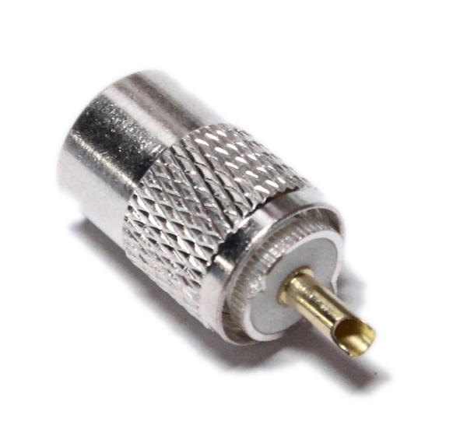
Feed Line & Connectors
Cable | Attenuation @ 144 MHz | Attenuation@ 440 MHz
LMR-400 | 1.5 | 2.6 | Best
RG-213 | 2.3 | 4.5 | Good
RG-8X | 4.6 | 8.5 | OK
RG-58 | 5.1 | 12 | Bad
RG-174 | 10.1 | 20 | Dummy load
Makes less difference on HF
Stick with RG-213 or RG-8X
Connectors N (Best) BNC (Good) UHF PL-259 (OK)

Slide 17
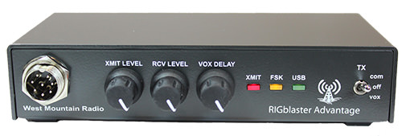
Accessories
SWR/Watt Meter
Computer Interface
Headset
External Speaker
Desk Mic

Slide 18
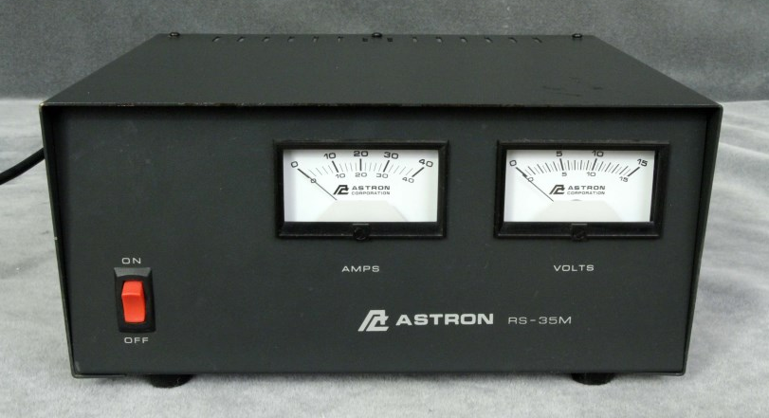
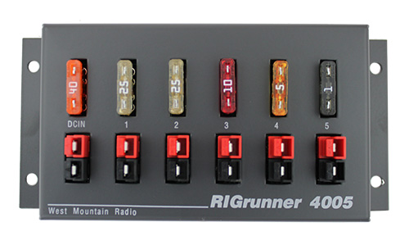
Power Supply
13.8 VDC
35 Amps
Fused power junction

Slide 19
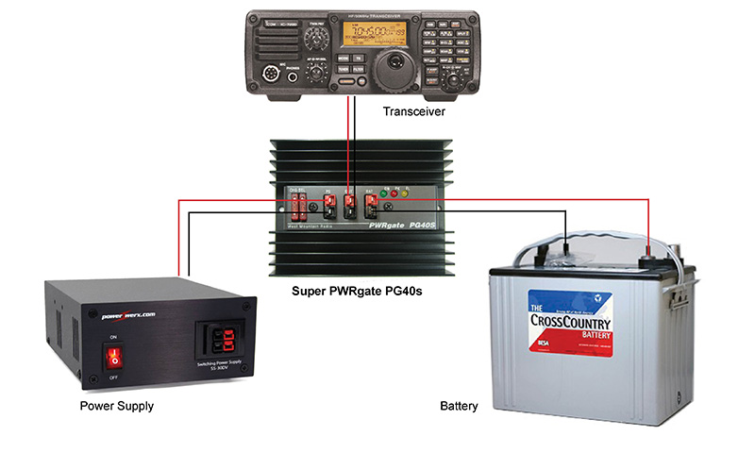
Battery Power

Slide 20
Antenna Tuners
Antenna tuner, a matchbox, transmatch, antenna tuning unit (ATU), or antenna coupler…
Connected between a radio and its antenna
Improves power transfer by matching impedance of the antenna to the radio
If you have a resonant antenna you don’t need a tuner
Tuner types
Internal vs external
Manual vs auto tuner
Balanced vs unbalanced
Antenna
External at the antenna
External in the shack
Internal

Slide 21
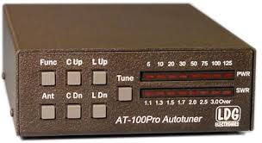
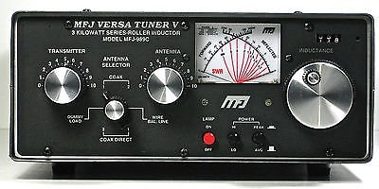
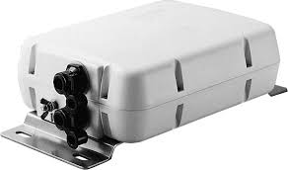
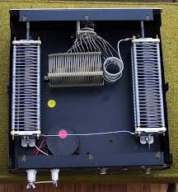
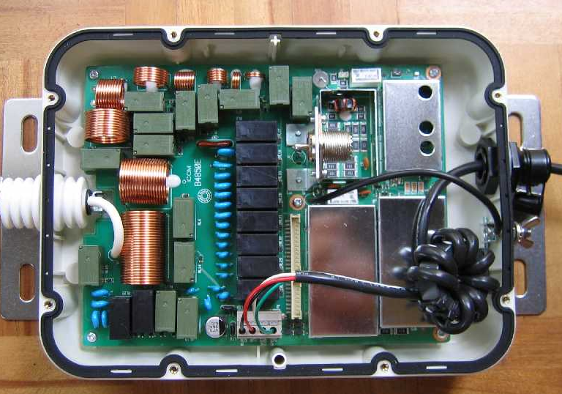
Antenna Tuners
External Auto Tuner
External Manual Tuner
Internal Tuners
Elecraft K3
Max 10:1 SWR range
Icom FT-991A
Max 3:1 SWR range
Up to 150 Ohms

Slide 22
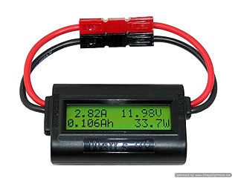
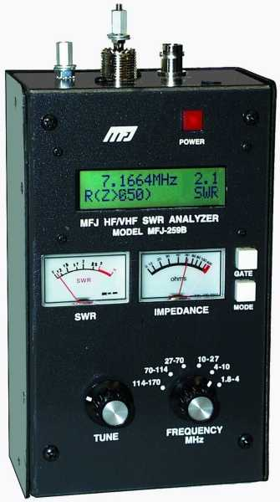
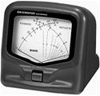
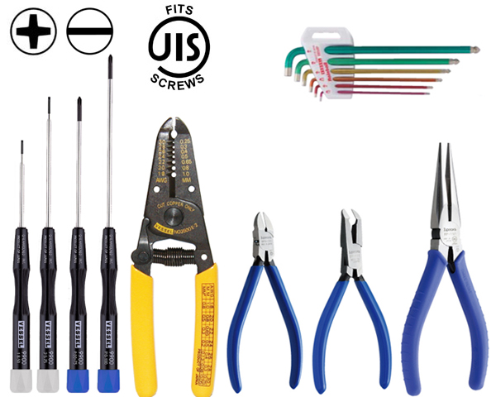
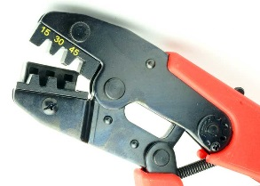
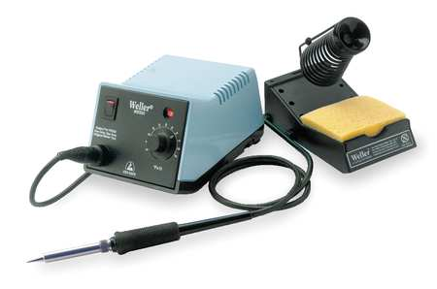
Tool Kit
In-Line
Volt / AMP Meter
Antenna
Analyzer
Digital Volt/Ohm Meter (VOM)
Watt Meter
Soldering Iron
& Hand tools
PowerPole Crimper

Slide 23
Parts Kit
PowerPole Connectors
Fuses
Coax adapters
Resistors
Capacitors
Coax connectors
Scotch 33+ Tape
Rescue Tape
Solder
Zip ties
Lugs

Slide 24
ARRL Handbook
Fundamental Theory
Electrical Fundamentals
Analog Basics
Digital Basics
Practical Design and Principles
RF Techniques
Computer-Aided Circuit Design
Power Supplies
Modulation
Oscillators and Synthesizers
Mixers, Modulators and Demodulators
RF and AF Filters
Receivers
Transmitters
Transceivers
Telemetry and Navigation
DSP and Software Radio Design
Digital Modes
RF Power Amplifiers
Repeaters
Antenna Systems and Radio Propagation
Propagation of Radio Signals
Transmission Lines
Antennas
Equipment Construction and Maintenance
Component Data and References
Construction Techniques
Station Accessories
Test Equipment and Measurements
Troubleshooting and Maintenance
RF Interference
Station Assembly and Management
Safety
Assembling a Station

Slide 25
Radio Advice…
Get a good quality / basic radio to start
Consider mobile radios
You will want to upgrade later
Do NOT start with a QRP radio
Any antenna is better than none
Dipoles and verticals are good starter antennas
Get the antenna as high as possible
Get a CW filter if you plan on operating CW
Invest in a good quality set of accessories and tools

Slide 26
10 Things You Should Do… In your 1st year
Set up your HF station
Join a local club … and Bay-Net !
Register for Logbook of the World
Work a contest
Get a copy of the ARRL handbook
Try digital modes on HF
Assist with organizing a Field Day event
Attend the Maker Faire (or Hamvention)
Build a wire antenna
Operate HF mobile or portable

