Slide 1
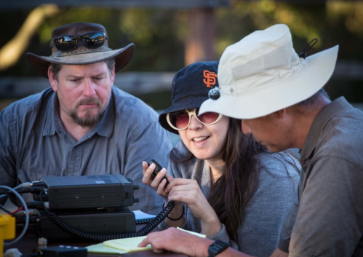
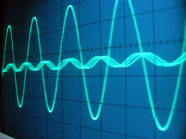
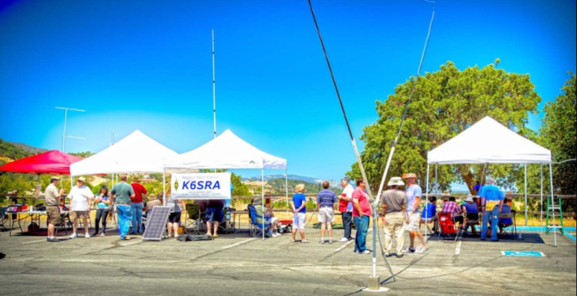
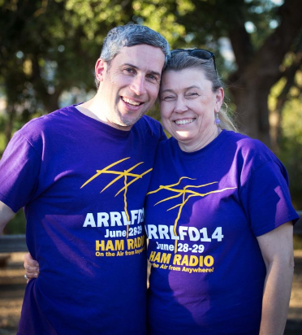
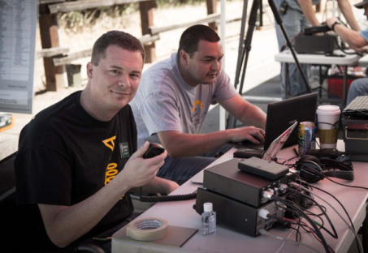
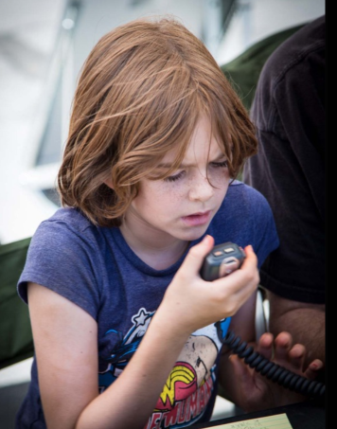
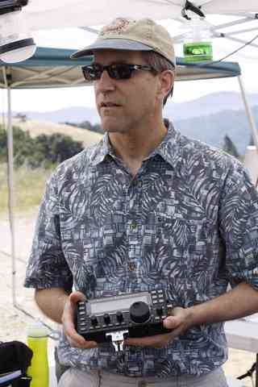
Welcome to Ham Radio 101 New Tech Session Sponsored by Bay-Net www.bay-net.org

Slide 2
Agenda
New Technician / New Licensee
8:00 Kickoff
8:15 VHF/UHF Gear - George
9:00 VHF/UHF Operating - Beric
9:45 VHF Digital Voice – George
New General / Extra
10:15 HF Gear - George
11:00 HF Operating - David
11:45 Q&A
12:00 Wrap up

Slide 3
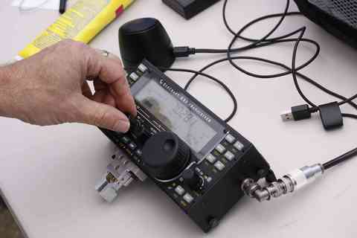
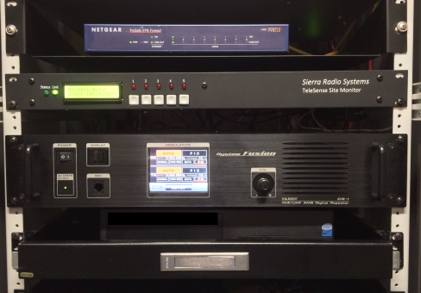
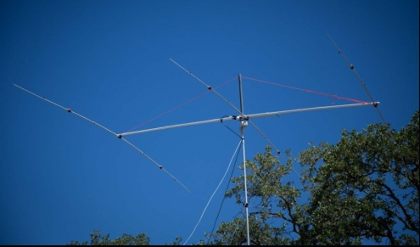
Bay-Net www.bay-net.org
Bay-Net
Virtual Amateur Radio Club
> 400 “members” – groups.io
7 repeaters @ 2 sites
Analog FM
DMR, D-Star & C4FM Digital
IRLP / EchoLink VOIP
Events
Field Day
Antenna Shootout
BayCon
Urban Shield
Supports
American Red Cross
FEMA USAR TF 3
Radio Mala - Nepal
501(C)3 Non-profit
Field Day !!!

Slide 4
Great Resources
Ham Radio Workbench Podcast www.hamradioworkbench.com
TX Factor www.tx factor.co.uk
The Doctor Is In www.arrl.org
QSO Today podcast www.qsotoday.com
Bay-Net website www.bay-net.org
BayCon 2020
Annual Bay-Net Radio Conference
February 8th - 9 AM – 5 PM
Plug-n-Play Tech Center – Sunnyvale

Slide 5
Terms…
“Station” - Your transceiver not specifically a place
“Shack” – Your home station
“Rig” – Your radio (even a hand held)
“Go Bag” or “Go Kit” – Organized set of accessories you can “grab and go” and be fully operational

Slide 6
Assumptions – You Want To Operate…
Portable/Handheld – “HT – In your hand”
Mobile radio - “In your car”
Base station - “In your shack”

Slide 7
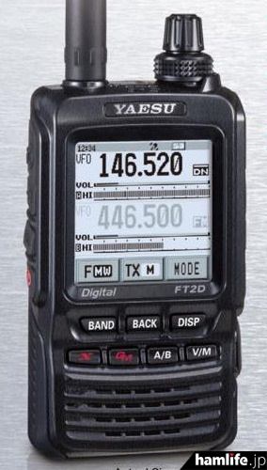
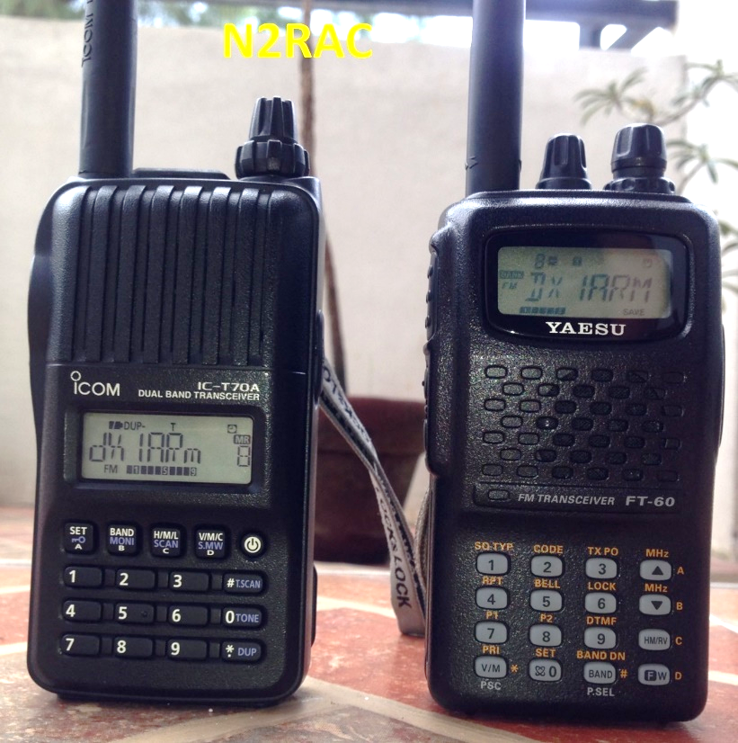
Choosing Your First HT
Go Feature-Rich
Go Mainstream
Go Cheap But Functional
Baofeng UV82~ $30
Upgrade later
Basic VHF/UHF
ICOM IC-T70A - $199
Yaesu FT-60 - $154
Solid Analog VHF/UHF
http://tinyurl.com/y7u8s8ty
Yaesu FT2D
$419 $369
Great radio ++
Digital, APRS, etc.

Slide 8
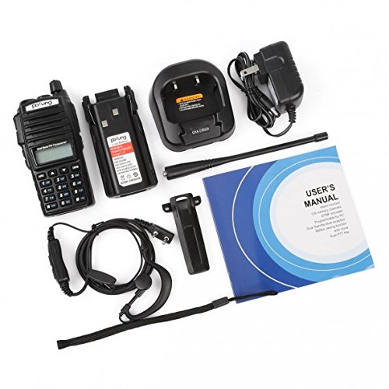
Choosing Your HT
Go Cheap But Functional
Start with a cheap HT <$100
Learn the basics
Camping / Hiking
On roof
Loaner
Upgrade later when you know what you want
D-STAR
System Fusion
DMR
APRS
Baofeng UV82
$30
Upgrade later

Slide 9
HT Accessories
Drop-in charger
External speaker / mic
Programming SW & cable
Bigger antenna
Ed Fong – roll up J-Pole antenna
Turn your HT into a mobile radio?
Mobile DC power cord
Mobile antenna
Power amplifier
External microphone
External speaker
Pro: Cost effective
Cons: Mess of wires.
Lower performance than a real mobile radio.

Slide 10
Mobile Radio
Radio…
Good: Single band (2m)
Better: Dual band 2m / UHF
More better: Dual band / dual VFO (V/V, V/U, U/U)
Best: Dual band / dual VFO ++
APRS / D-Star digital / C4FM digital
Antenna…
For repeaters – small is fine
For simplex – bigger is better
Mounts are equally good: Magmount, bracket, hole

Slide 11
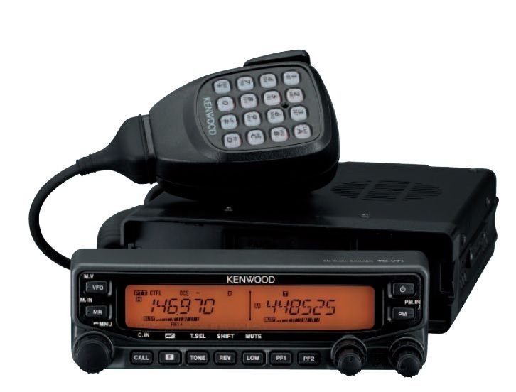
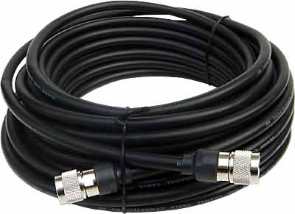
Base Station
50’ RG-8X
$40
Kenwood TM-V71A
Dual band / Dual VFO
Easy to use
APRS capable.
$335 ~
Comet X-50A
$89 ~
Powerwerx
30A Switching power supply
$110 ~

Slide 12
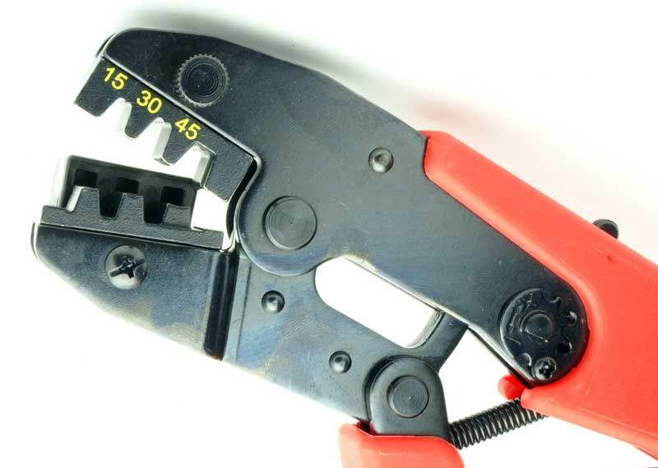
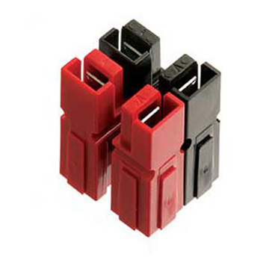
Standardize on Power Pole Connectors
Anderson Power Pole
THE standard for ARES / RACES interoperability
Buy them at any amateur radio store
Easy to use
Buy the crimper if you plan to make a lot of connections
CQCQCQ!

Slide 13
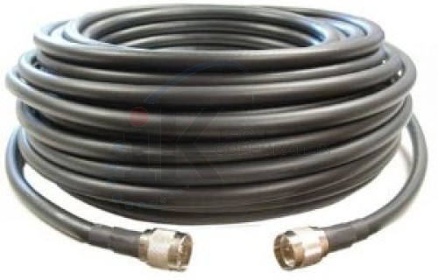
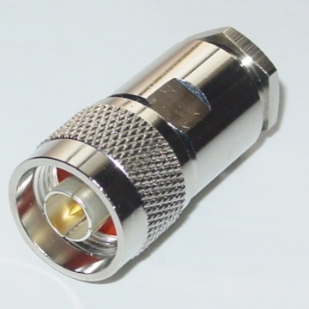
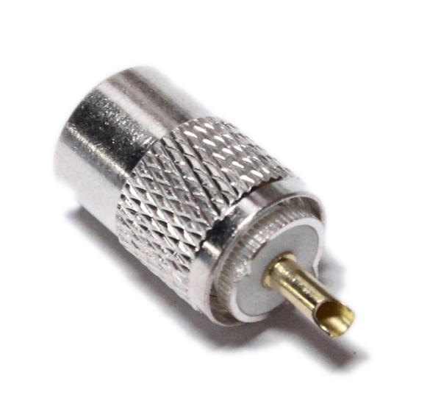
Feed Line & Connectors
Cable Type | Attenuation @ 144 MHz | Attenuation@ 440 MHz | Advice…
LMR-400 | 1.5 | 2.6 | Best
RG-213 | 2.3 | 4.5 | Good
RG-8X | 4.6 | 8.5 | OK
RG-58 | 5.1 | 12 | Bad
RG-174 | 10.1 | 20 | Dummy load
Connectors N (Best) BNC (Good) UHF PL-259 (OK)

Slide 14
Learn to Program Your Radio
Set frequency, offset, tone, power
Save into a memory
Advanced features
Program your memories in banks
Favorite repeaters
More repeaters
Simplex
Public safety, weather, etc…
Program multiple radios (HT, mobile) with the same channel / frequency assignments

Slide 15
More Programming Options
RT Systems radio specific software & cables
Icom/Kenwood/Yaesu/Wouxun make software for their radios
“KG-UV Commander” - Free software for Wouxun
Chirp – Free software for many radios
Radio Reference web site – Public service frequency lists
http://www.radioreference.com
Repeater Book is a great web site for finding local and remote repeaters
iPhone & Android apps – Also has API Chirp can access
http://www.repeaterbook.com

Slide 16
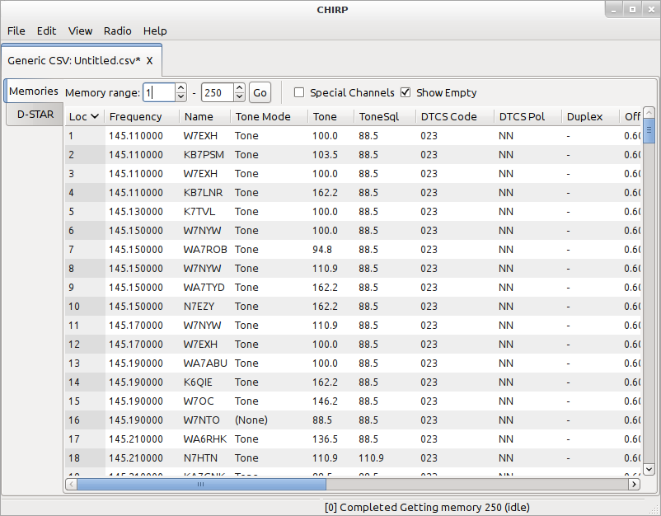
Programming Your Radio
“Chirp” software is a way to program many radios with the appropriate cable
Choosing your first radio.
Choosing your first radio.

Slide 17
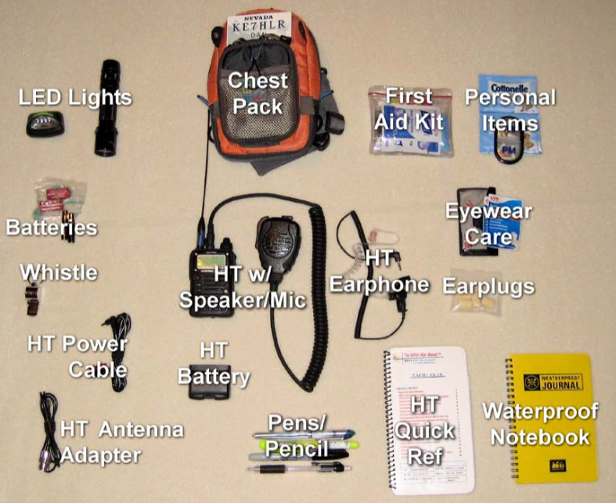
Go Kit – Be Prepared
Detailed Go-Kit Info at
www.bay-net.org
2M/UHF HT Radio
Battery (rechargeable)
Battery (AA)
Charger & Power cord
External mic & earphone
First aid kit
Notebook and pen
Flashlight & headlamp
Batteries & FM Radio
Kleenex
Personal items
Frequency directory
SUN BLOCK!!!!11!1oneone

Slide 18
Radio Advice…
Get a cheap HT. Good to start, useful later.
Upgrade to a better HT when you know what you want
D-STAR / Fusion / DMR / APRS ???
Add a mobile radio for better performance
Outside antennas make a big difference
Program your local favorite frequencies (like Bay-Net!!!)
Standardize on Anderson Power Pole connectors

Slide 19
10 Things to do in your first year
Get a radio
Learn how to use it
Find a friendly repeater
Listen to the repeater
Join a club or find an “Elmer”
Get on the air, simplex & repeater
Go to a ham radio convention (CHECK!)
Show your friends
Go to a Field Day or other contesting event

Slide 20
Q&A

